Slide 1
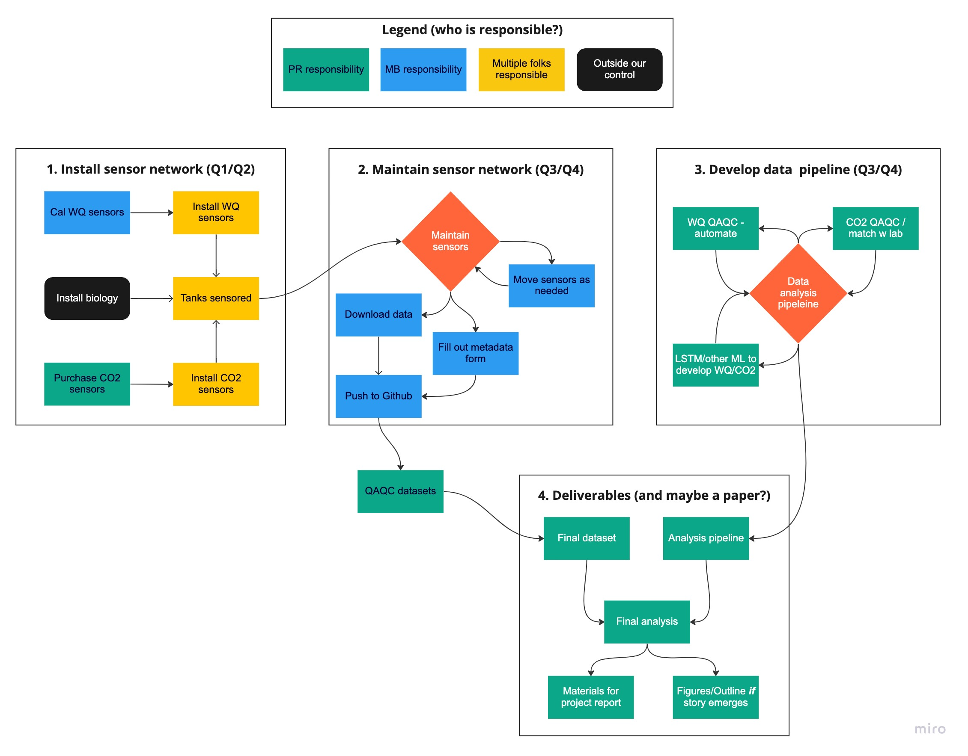
mCDR AOP monthly update: February
Task 2a: Mesocosm instruments/infrastructure
Peter Regier, Emma Cotter
Data, images, schematics etc.
Long-term Goals
Develop a continuous monitoring sensor package of CO₂ dynamics for diverse mesocosm and coastal system applications
Flowchart of project tasks, how they relate, and who is responsible
FY23 Project Objectives
Identify instrument package useful for mesocosm CO₂ and water quality monitoring
Purchase, deploy, maintain, and iterate
Approach
Current Challenges
Get vendor quotes for improved CO2 sensors – Q1
Select (in coordination with Task 2b) and order CO₂ sensors – Q2
Deploy CO₂ sensors and water quality sensors – Q3/Q4
Work up dataset and report out – Q4
Working out sensor logistics – wiring/logging/etc
Once sensors are received, will need to install in coordination with Task 2b renovations
Deliverables
Recent Successes
Ground-truthing sensor capabilities in a controlled setting: does our selected system do what we need?
Developing SOPs for deployment/maintenance
Developing a ML data analysis pipeline
Collecting a potentially publishable dataset (water quality as a proxy for CO₂)
Sensors ordered! – delivered late March / early April
Inventory of available water quality sensors completed
Maintenance tentatively sorted out - Bowe
Developing an approach to link CO2 sensors ($$$) to water quality sensors (in hand)

